Slide 1
Don't f*** up your files
Or... Where is my data?

Slide 3
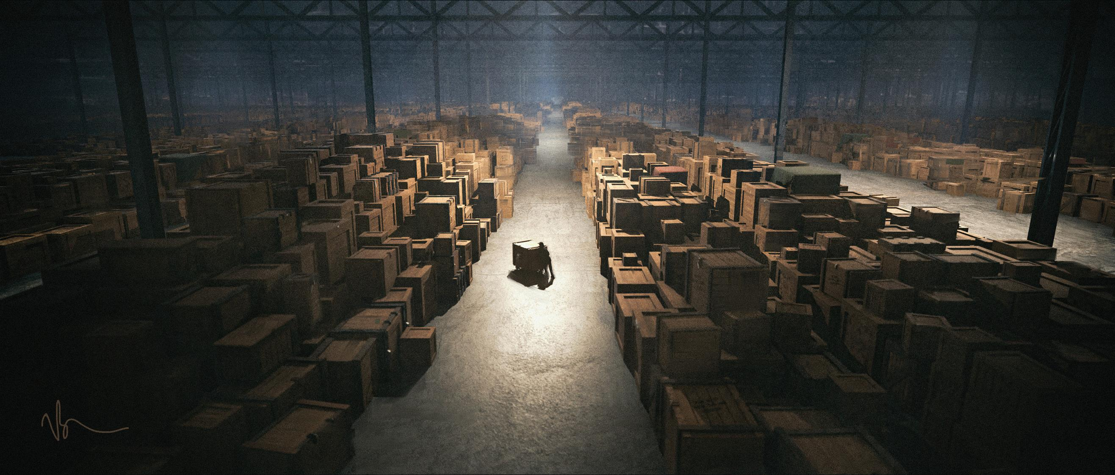
Notes:
You think it looks like this. Organised, categorised and secure

Slide 4
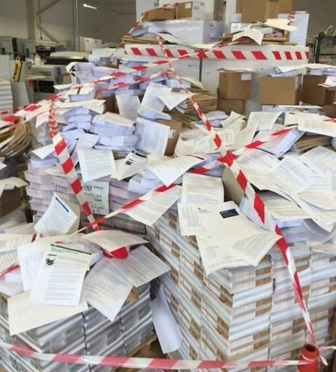
Notes:
More like this in most businesses when you look deeper.
Copies in everyone’s email, desktops, cloud storage, online, USB devices.

Slide 5
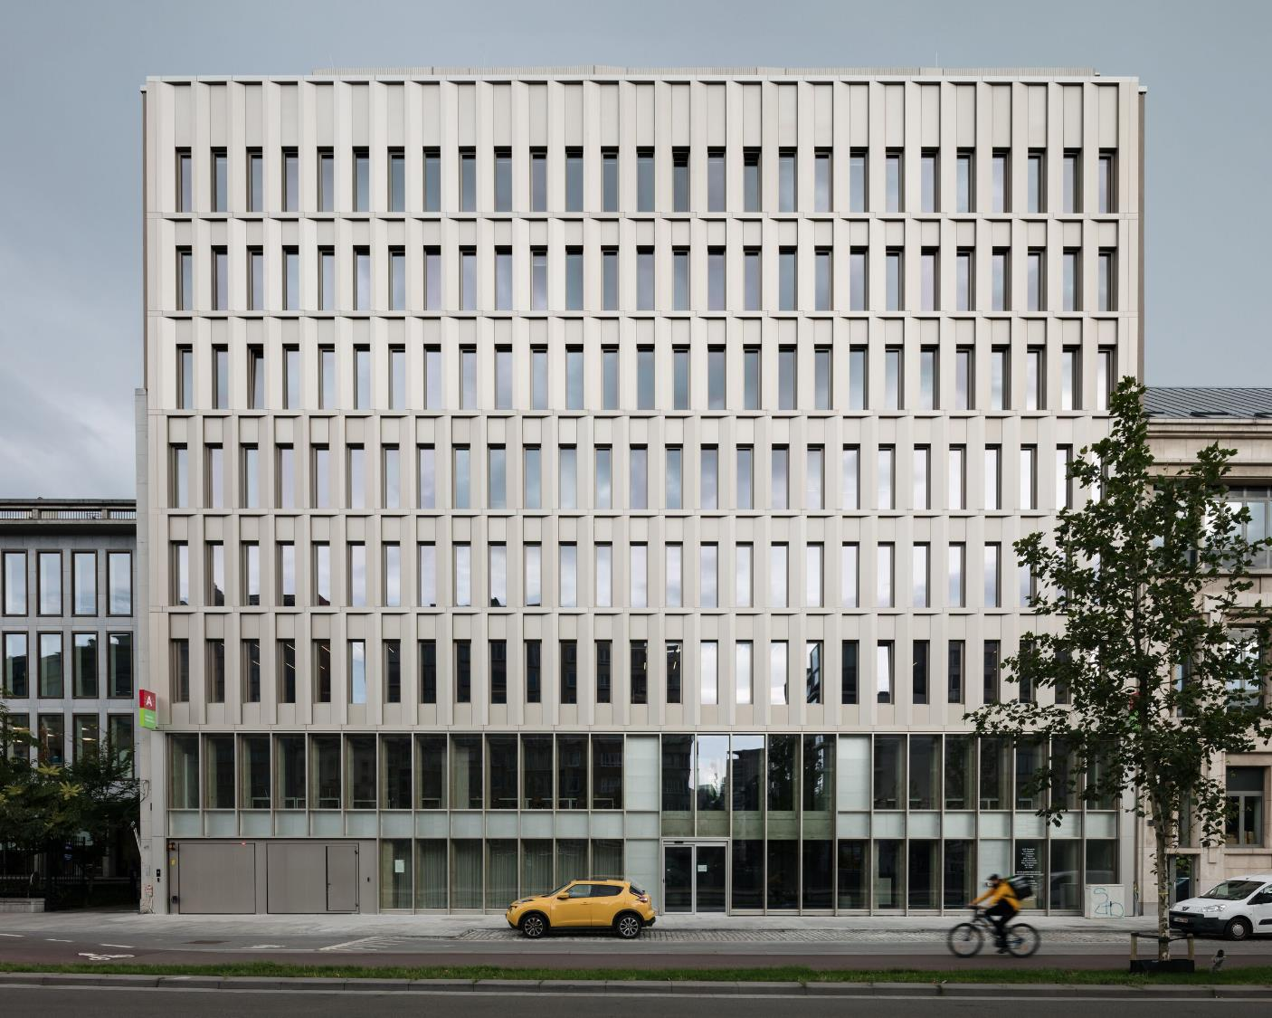
Notes:
Everything used to be in one place. Servers, computers, filing. Nothing left these four walls.

Slide 6
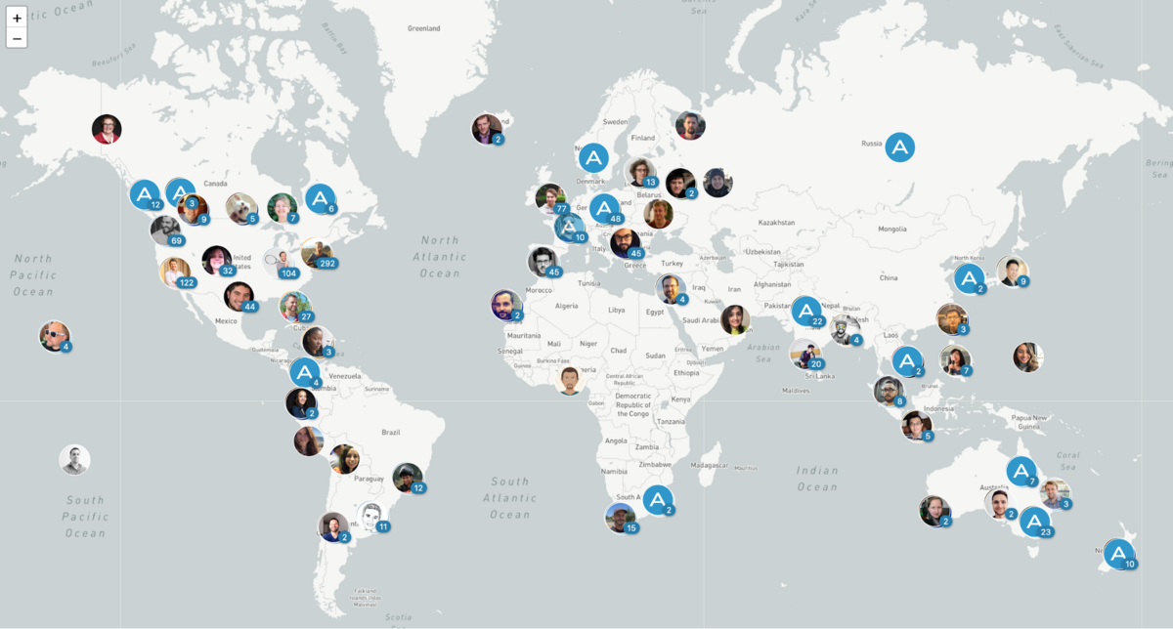
Notes:
Now it looks more like these. People, devices, cloud storage, online services. Its all over the place.
How do you build a defensive wall around your data and manage it?

Slide 7
Hello ICO Case Officer. The following is true….
I can evidence where my data is
Everyone can find the latest version
I know who can access my data
I can easily control access to data

Slide 8
Sorry to hear you’re leaving
I know what devices you have data on
I know you don’t have copies
I know what data you can access
I can remove your access to my data

Slide 9
Where is your data?
Where are the latest version/copies?
How is it accessed and by who?
How do you control access?

Slide 10
1. Where is your data?
Where is your data?
OneDrive / SharePoint / Google Drive / Dropbox
Computers
Mobile devices
USB drives
Website
CRM
Other online services

Slide 11
Where are the latest version/copies?
Local copies
Version control
Managing changes
Easy access to avoid workarounds
Notes:
Pricing, contracts, marketing

Slide 12
How is it accessed and by who?
Personal accounts
Local logins
Third parties
Subcontractors
Passwords

Slide 13
How do you control access?
Unique logins
Starter/leaver processes
Access reviews
Access by default
Centralised control

Slide 14
I can evidence where my data is
Everyone can find the latest version
I know who can access my data
I can easily control access to data

Slide 15
Data Experts are on hand
1 hour kick-start session
2 employees
3 services
4 free!
data@blucando.it – 0333 123 3007
Notes:
ben.fielding@blucando.it – 0333 123 3007

